Slide 1
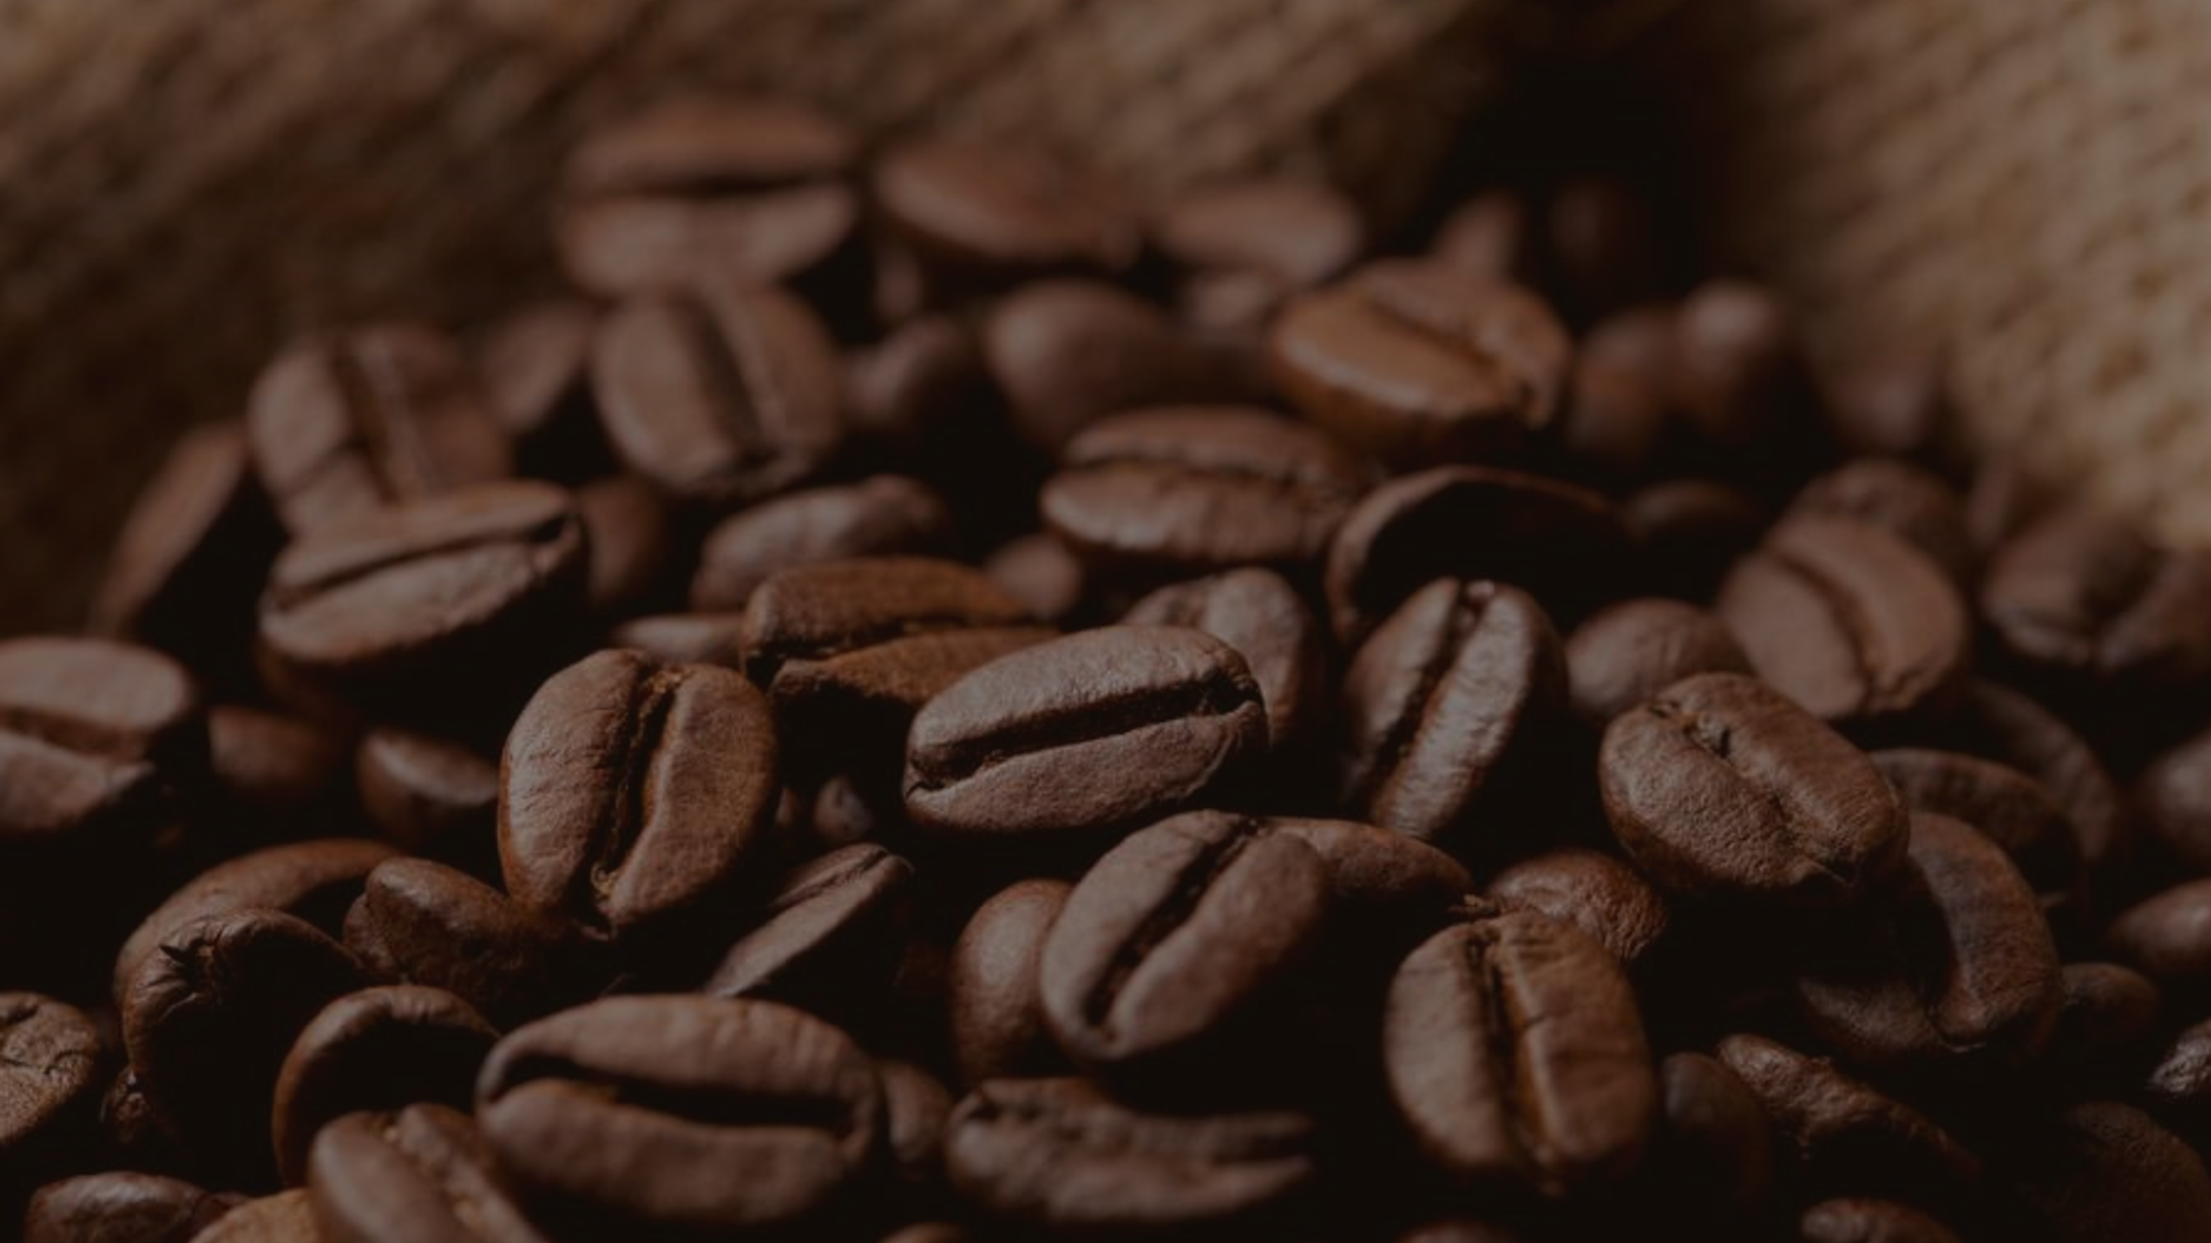
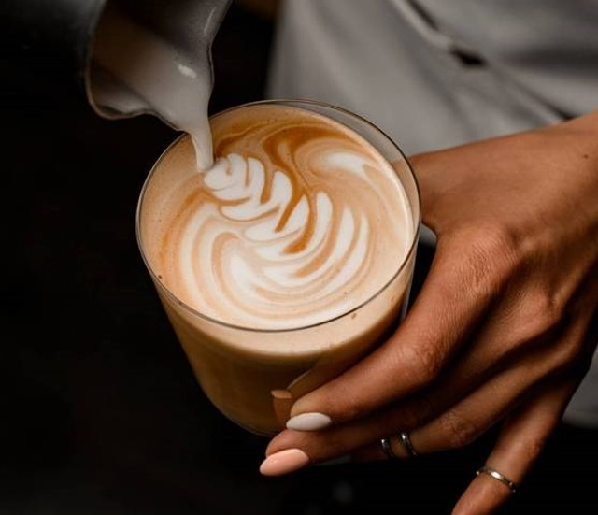
By TRINITY THUBA NGOMANE
Bright coffee shop Presentation

Slide 2

BRIGHT COFFEE SHOP
Bakery
branded
Coffee beans
Loose tea
Drinking chocolate
Biscotti
Pastry
Scone
Clothing
Housewares
Barista Espresso
Drip coffee
Gourmet brewed coffee
Organic brewed coffee
Premium brewed coffee
Brewed Black tea
Brewed Chai tea
Brewed Green tea
Brewed herbal tea
Drinking Chocolate
Organic Chocolate Hot chocolate
OUR Major PROCUCTS

Slide 3
The Market
Store Location | REVENUE % | REVENUE RANDS
Astoria | 33,23% | R232 243,91
Hell's Kitchen | 33,84% | R236 511,17
Lower Manhattan | 32,92% | R230 057,25
Grand Total |  | R698 812,33

Slide 4
Revenue per month

Slide 5
Sales vs revenue per product type
Row Labels | Count of NUMBER_OF_SALES | Sum of REVENUE
Bakery | R18140 | R82315,64
Branded | R697 | R13607
Coffee | R45158 | R269952,45
Coffee beans | R1683 | R40085,25
Drinking Chocolate | R8887 | R72416
Flavours | R5012 | R8408,8
Loose Tea | R1164 | R11213,6
Packaged Chocolate | R480 | R4407,64
Tea | R35078 | R196405,95
Grand Total | R116299 | R698812,33

Slide 6
Revenue per time of the day
The data shows that the coffee shop generates the highest revenue during the morning hours, followed by the afternoon, and the evening having the lowest sales. This trend suggests that most customers visit the coffee shop in the morning, likely to purchase coffee and breakfast items as part of their daily routine before work or school.
The afternoon period also contributes significantly to total sales, possibly driven by customers seeking a midday boost or engaging in social or business meetings. Although evening sales are comparatively lower, they may represent customers looking to relax or enjoy a light snack after work.

Slide 7
COFFEE INFOGRAPHICS
Lower Manhattan records the highest sales overall, especially in the morning where revenue reaches around R400 000. This suggests that the area benefits from high foot traffic, likely due to office workers and commuters.
Hell’s Kitchen shows moderate performance, generating about R250,000 in the morning and following a similar downward trend as the day progresses.
Astoria consistently records the lowest sales, though it maintains steady performance throughout the day, suggesting a smaller but loyal customer base.

Slide 8
Number of Sales vs day of the week
Peak day: Thursday (~17,000 sales)
Lowest day: Saturday (~15,900 sales)
Pattern: Stronger sales midweek, weaker at the weekend
Sales fluctuate throughout the week with noticeable peaks and dips, indicating that buying activity is not consistent across all days.

Slide 9
RECOMMENDATIONS
Maximize Morning Operations - Since mornings generate the highest revenue, ensure adequate staffing and fast service during peak hours.
Boost Afternoon Sales- Introduce midday promotions, such as “Buy 1 Get 1 Half Price”.
Promote cold beverages and light snacks that appeal to customers looking for an energy boost or refreshment after lunch.
Increase Evening Traffic- Create a more relaxed atmosphere with softer music and lighting, encouraging customers to unwind after work.
Data-Driven Improvements- Continue tracking hourly sales data to identify new peak times or seasonal trends.
Collect customer feedback to adjust menu options and pricing strategies accordingly.

Slide 10

RECOMMENDATIONS
Maximize Morning Operations - Since mornings generate the highest revenue, ensure adequate staffing and fast service during peak hours.
Boost Afternoon Sales- Introduce midday promotions, such as “Buy 1 Get 1 Half Price”.
Promote cold beverages and light snacks that appeal to customers looking for an energy boost or refreshment after lunch.
Increase Evening Traffic- Create a more relaxed atmosphere with softer music and lighting, encouraging customers to unwind after work.
Data-Driven Improvements- Continue tracking hourly sales data to identify new peak times or seasonal trends.
Collect customer feedback to adjust menu options and pricing strategies accordingly.

Slide 11
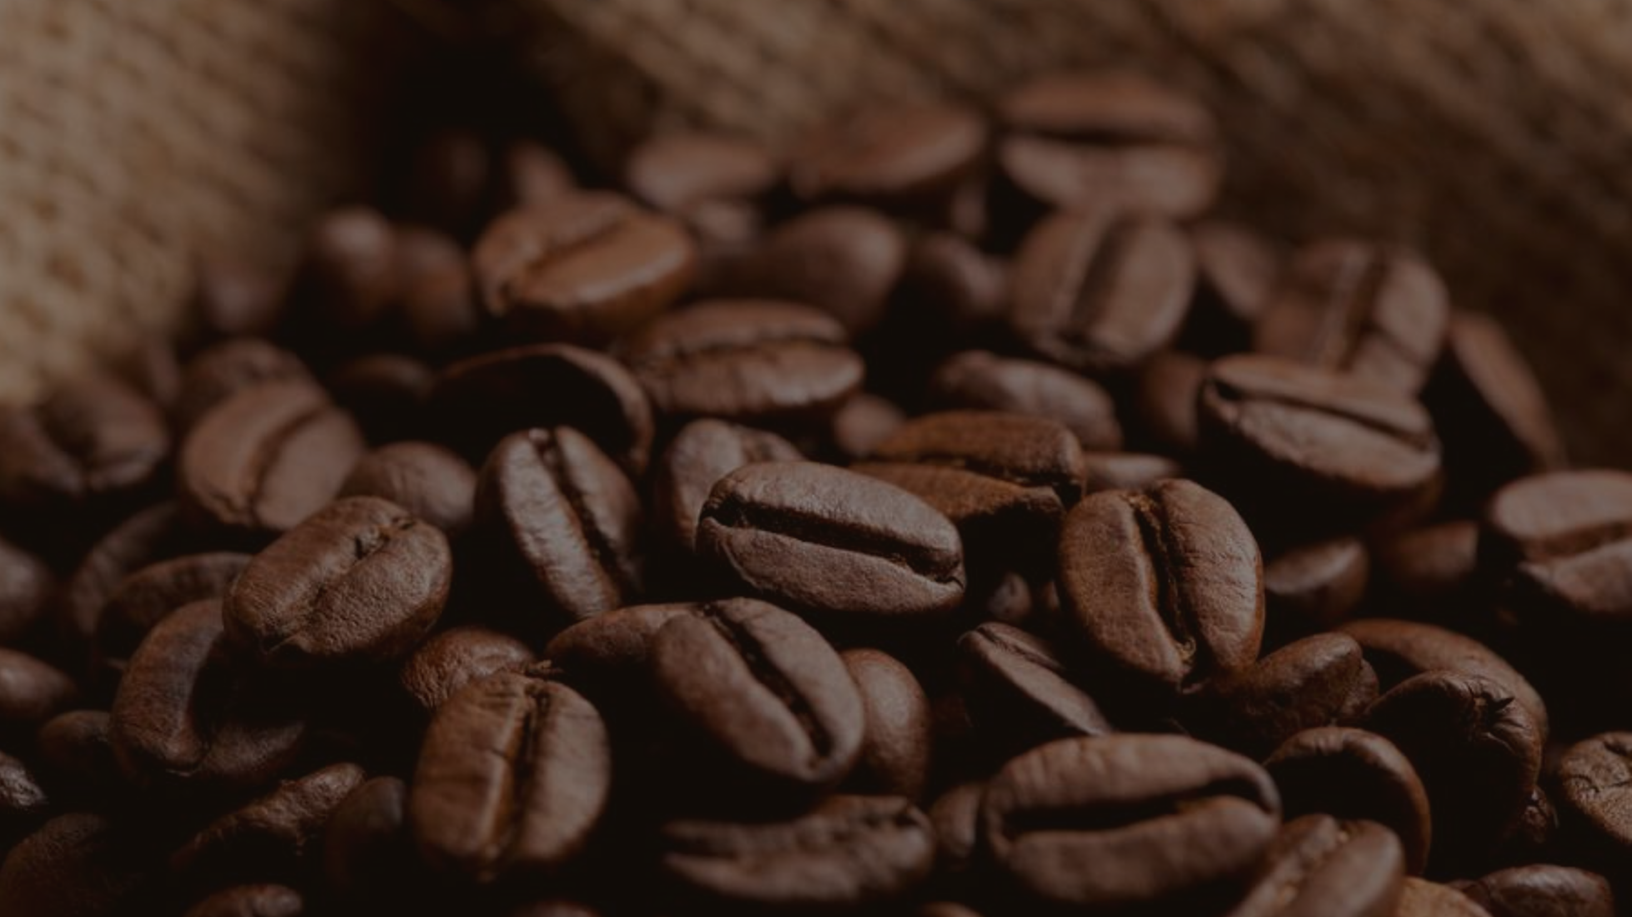
Thank you

